Slide 1
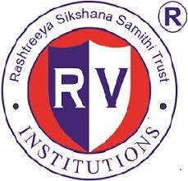
INNOVATIVE Farming
R V COLLEGE OF ENGINEERING
BENGALURU-560059
(An Autonomous Institution Affiliated to VTU, Belagavi)
USN 1RV17EC159 NAME: SONALI A. KARKI
USN 1RV17EC161 NAME: SPOORTHI G. GOJANUR

Slide 2
Table of Contents
Introduction
Motivation
Objectives
Literature Survey
Methodology and Specifications
Work carried out till date
Results
Conclusion
Work Plan
References

Slide 3
Introduction
With technology gaining steady momentum in today’s scenario, it is no surprise that the agricultural segment is catching up with the same.
The rising population demands for sustainable and efficient methods to be adopted. This in return, necessitates the need to incorporate high-precision predictive techniques and resource-efficient approaches in agricultural production.
Integrating upcoming technological trends into existing methodologies is the key to cater to the ever-increasing market needs.

Slide 4
The application of modern information and communication technology solutions such as IoT, sensors and actuators, precision equipment, drones, etc in farming is what we call “Innovative-Smart Farming”.
Innovative farming has the potential to maximize production outputs, while simultaneously minimizing cost and preserving resources.

Slide 5
Motivation
As mentioned earlier, the demand for better and larger agricultural produce has increased. Statistically speaking, agricultural incomes are rising by only 1.5 per cent, while consumption expenditure is going up by almost 4 per cent each year.
In the past few years, over 4,000 farmers have killed themselves, trapped in a vicious cycle of debt, crop failure and penury. Nearly half of Indian farmers are gripped by debt. The total short-term credit required for crops is about Rs 1 lakh crore a year. Financial institutions supply only 12-14 per cent of this.
We clearly saw a problem statement in these statistical facts. Keeping that in mind, we decided on devising an effective ICT solution for the same.

Slide 6
Objectives
To use sensors and actuators in combination with wireless information and communication technology to mould an automated alternative for agricultural farming.
To create a user-friendly and an easily-comprehensible GUI app for the display of data, its associated parameters and interpreted information.

Slide 7
Literature Survey
Technological advancement, such as the use of electronic systems and data transmission, has introduced radical changes to the agricultural sector in the recent years. These changes demand updated information from production systems, markets and agents involved in production, to provide better decision-making information for production, strategic and managerial aspects of agriculture
Innovative farming, is based on the integration of information and communication technologies into machinery, equipment and sensors in agricultural production systems. It provides for large amounts data and information to be generated superimposed with automation. Smart farming relies on data transmission and the data concentration in remote storage systems to enable the combination and analysis of various farm data.
Demographic trends like aging populations and continued migration of people from rural to urban areas, have attracted the attention of researchers, because labor issues may become a scarcity factor in agriculture. In addition, the intensification of climate change will continue to alter growing conditions, such as the temperature, precipitation, and soil moisture, in haphazard ways. Innovative farming tools can help reduce these adverse impacts due to these irregular trends, and further reduce production costs in agricultural activities.

Slide 8
The literature on smart farming and smart agriculture is recent. The concept and terms associated with SF have not reached a consensus in the scientific literature. The basis for advancement in this sector involves a combination of internet technologies and future-oriented technologies for use as smart objects Rapid developments in the internet of things, wireless communication and cloud computing are propelling the phenomenon so-called innovative farming. However, there is no still established concept for these technologies in agriculture.
Considering this context, this presentation aims to achieve the following objectives:
Identifying how science frames innovative farming over time and geographic demographics.
Technical aspects that may determine the emergence of a new technical-economic paradigm in agriculture; a new techno-economic paradigm, corresponding to a new set of more profitable and viable productive practices – in terms of inputs, methods and technology choices.
Nayyar, Anand. Puri, Vikram. “Smart Farming: IoT Based Smart Sensors Agriculture Stick for Live Temperature and Moisture Monitoring using Arduino, Cloud Computing & Solar Technology”

Slide 9
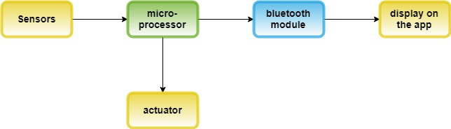
Methodology and Specifications
Having a schematic draft of the approach towards the problem statement, before actually getting into the dynamics of it, has worked to the advantage of many. Choosing to tackle our project similarly, we sketched a blueprint, keeping in mind, the bigger picture.

Slide 10
This model has been developed using three sensors; a LDR (a resistor sensitive to light), a moisture sensor and a temperature and humidity determining sensor. Apart from these, a 14-pin ATmega328-based microcontroller board – Arduino Uno board, and other basic required components have been used.
To display the procured raw data and the conclusions drawn after analyzing the data, an app was developed using an open-source web application – MIT app inventor.
The model is designed to get soil moisture level and the values of atmospheric humidity and temperature, using which rainfall is predicted. The LDR sensor gives the intensity of sunlight in the region, which is also a vital parameter in determining the essential conditions required for the crop growth.

Slide 11
Work carried out till date
An elaborate work plan has been drafted.
The required components have been purchased.
Each component has been tried and tested to check its functionality.
The circuits have been designed.
Development of the app has been started.

Slide 12
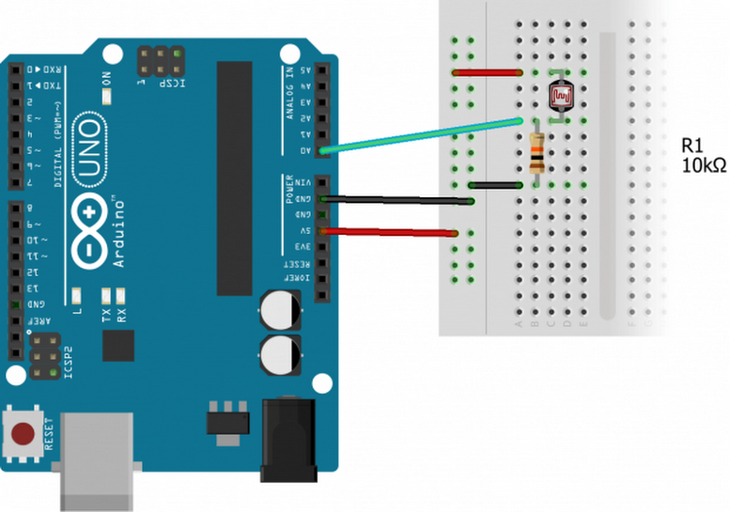
LDR circuit connection

Slide 13
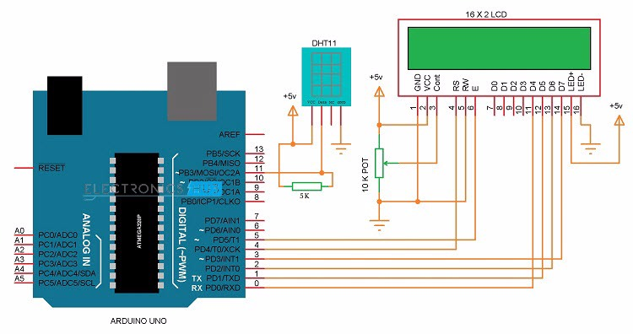
Temperature and Humidity sensor with LCD display

Slide 14
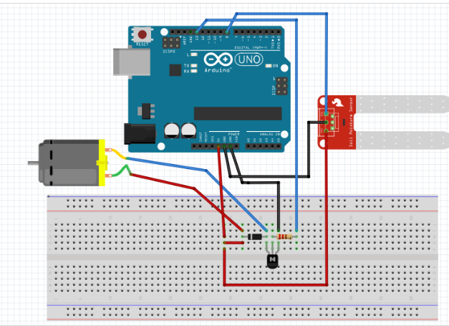
Moisture sensor circuit connection

Slide 15
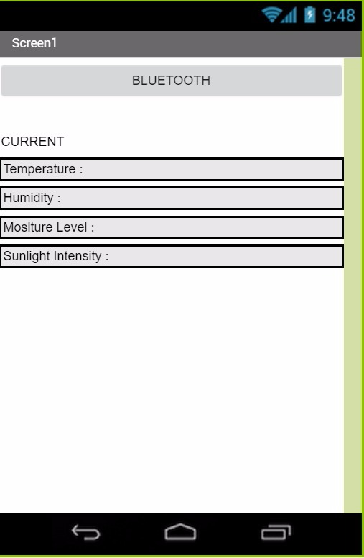
Partial User Interface of the mobile application

Slide 16
Results
Every component purchased, has been tried and tested, and the working of each component was comprehended. We saw that each sensor gave values close to the actual values, which leads us to believe that our final model would be sufficiently precise and accurate to be implemented in real-time analysis.
Speaking of the app, we have so far been successful in partially designing the user-interface of the app.

Slide 17
Conclusion
To sum it all up, we believe to have come up with a constructive product; constructive in the following aspects:
Rainfall prediction
Determining optimum moisture levels
Automated watering for soil moisture-level regulation.
Wireless communication of data , for agricultural management from a distance.
Reducing manual labor.
Economically beneficial.

Slide 18
Work Plan
Having finished the first phase of our project, we now aim to present a fully-working prototype of our model, at the end of the second phase.
Our final model will have a fully functioning mobile application communicating via Bluetooth with the sensors, to give atmospheric data, thus enabling the model to make rainfall predictions, determine and set optimum conditions

Slide 19
References
Shastri, Paromita. “A Harvest of Misery.” Outlook India 4 July. 2005.
Nattapol Kaewmard, Saiyan Saiyod, "Sensor data collection and irrigation control on vegetable crop using smart phone and wireless sensor networks for smart farm", IEEE Conference on Wireless sensors (ICWiSE), pp. 106-112, 2014.
HaiqingYang, Yong He, "Wireless Sensor Network for Orchard Soil and Climate Monitoring", Computer Science and Information Engineering 2009 WRI World Congress, vol. 1, pp. 58-62, 2009.
https://circuitdigest.com/microcontroller-projects/arduino-light-sensor-using-ldr
https://www.electronicshub.org/dht11-humidity-sensor-arduino/
Nayyar, Anand. Puri, Vikram. “Smart Farming: IoT Based Smart Sensors Agriculture Stick for Live Temperature and Moisture Monitoring using Arduino, Cloud Computing & Solar Technology”

